Slide 1
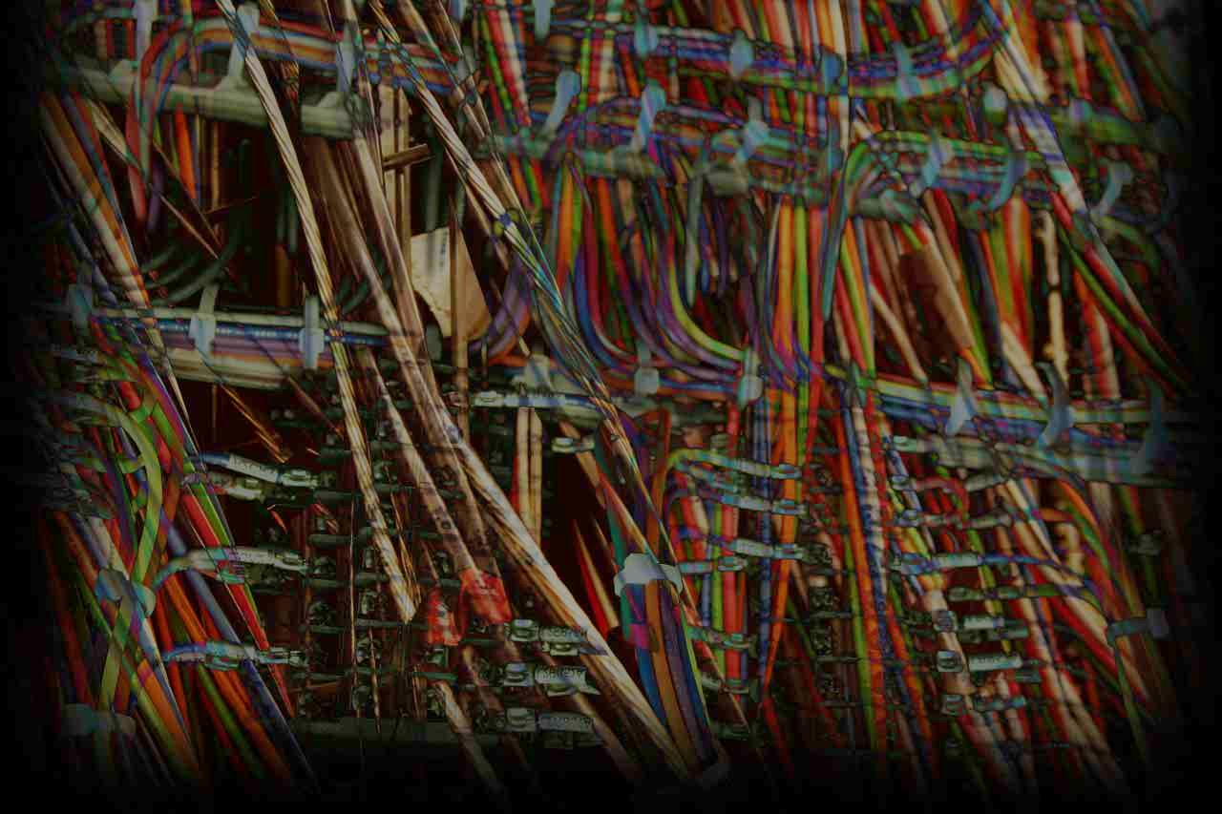


Taken Out of Context:
Language Theoretic Security
& Potential Applications for ICS
Darren Highfill, UtiliSec
Sergey Bratus, Dartmouth
Meredith Patterson, Upstanding Hackers
darren@utilisec.com
sergey@cs.dartmouth.edu
clonearmy@gmail.com

Slide 2
What’s the Problem?
How do we distinguish between benign and malicious input?
Trial and error → accumulation of malicious code profiles
What do we do about new exploits?
Trust the source
What happens when our source is compromised?
Bottom Line: Given a specific input, can we determine if it is safe to process?

Slide 3
Foundational Concepts
The Halting Problem
“Given a description of an arbitrary computer program, decide whether the program finishes running or continues to run forever.”
Alan Turing proved no algorithm can exist which will always correctly decide whether a given arbitrary program and its input will halt
Any such algorithm can be made to contradict itself, and therefore cannot be correct.

Slide 4
Foundational Concepts
Parsing vs. Processing
Simple: it matches or it doesn’t
Harder: it can match multiple different things
Complex: matching depends on other information
Do we need to execute any “if” logic?
Separating the parsing from the processing turns out to be an achievable* and valuable step
“Sufficiently complex input is indistinguishable from executable byte code.”

Slide 5
Foundational Concepts
“Shotgun” Parsers
Many parsers do all kinds of input checking
Unfortunately, much of this input checking is scattered all over the program
Have a dense-enough collection of checks, and you are likely to hit most things (although the attacker only has to find one miss!)
Fuzzing
Tends to find the white space between the individual pellet marks
In a way, is the (semi-random) inverse of defining valid input

Slide 6
Foundational Concepts
Language Formalism
Noam Chomsky: containment hierarchy of formal grammars
Regular
Context Free
Context Sensitive
Recursively Enumerable
Context Dependency
Do you have to have additional information to determine value or meaning?

Slide 7
Foundational Concepts
Weird Machines
Hidden functionality unintentionally built into a device
Discovered by security researchers
Distinct from reprogramming
Using the intended functionality in unintended ways
Hypothesis: Machine A has a hidden Machine B inside
Exploit is proof of existence of Machine B

Slide 8
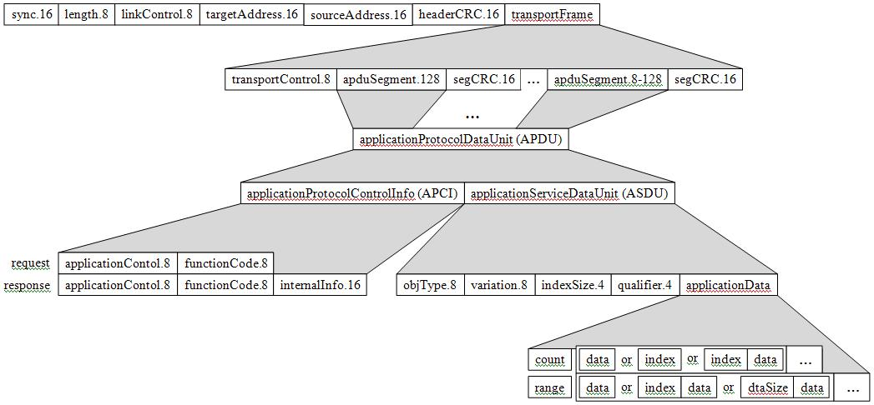
Applying Concepts to Technology
Parsers all the way down
Notes:
Each independent protocol frame/message element has a parser. The parser for the whole frame/message is a composition of these parsers. (Bonus: that way parsing code for each level of element can be tested separately, and it's clear how/where to add parsing for new syntactic elements if need be). This works best for context-free grammars (parsers for elements on the same level can be fully independent of each other)

Slide 9
Introduction to Hammer
Hammer parser looks like an input grammar spec
vs. typical C code (difficult to tell what its supposed to parse)
From syntax to semantics: semantic actions
Wait to start processing until fully parsed & validated
Clean separation of semantics & syntax
Well-governed feature addition
Where to add new features/functionality?
Boundary between parsing & processing guides code evolution
Notes:
From code for a typical parser in C, it's hard to recover the spec of the what it's supposed to parse. Grammar abstractions mix with C details of memory allocation, state keeping, etc. Not so with Hammer: Hammer parser code resembles a grammar spec, and is easier to read.
Parser bugs tend to come from starting to process input data too early: e.g., doing memory allocation, copying, and pointer arithmetic before it's fully parsed & recognized as valid. Hammer style gives processing code a proper place, where it could be safely written, to run only when syntax-checking part is over.
When new functionality/feature needs to be added to an existing parser, it's often not clear where to add it: to the syntax part? To an existing action? This leads to bugs even for parsers that were initially generated from specs. Hammer semantic actions (previous point) give a clear boundary at which to add code for new features.

Slide 10
Example: DNP3 Parser Bug
[code slide?]

Slide 11
Conclusion
Potential Applications
Open-source library of input parsers
Vendors can re-use well-examined code (instead of having to re-write)
Refinement of fuzz-testing tools
Variations based on input-parsing definition
Impact
Moving toward whitelisting-style input validation
Proven track record of bug reduction

